Slide 1
Fossil fuel emissions
Silvia Caldararu
Email: caldaras@tcd.ie

Slide 2

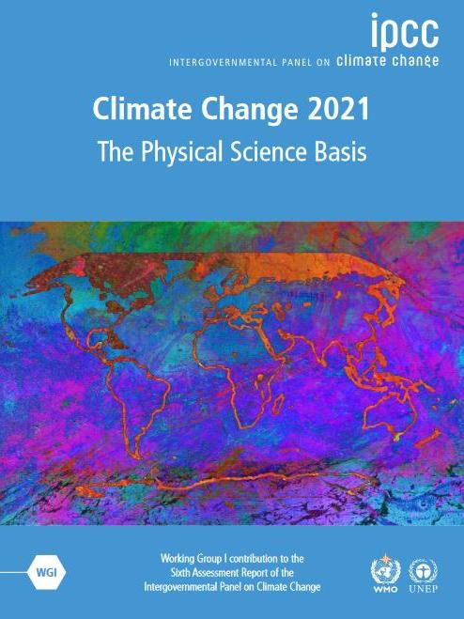
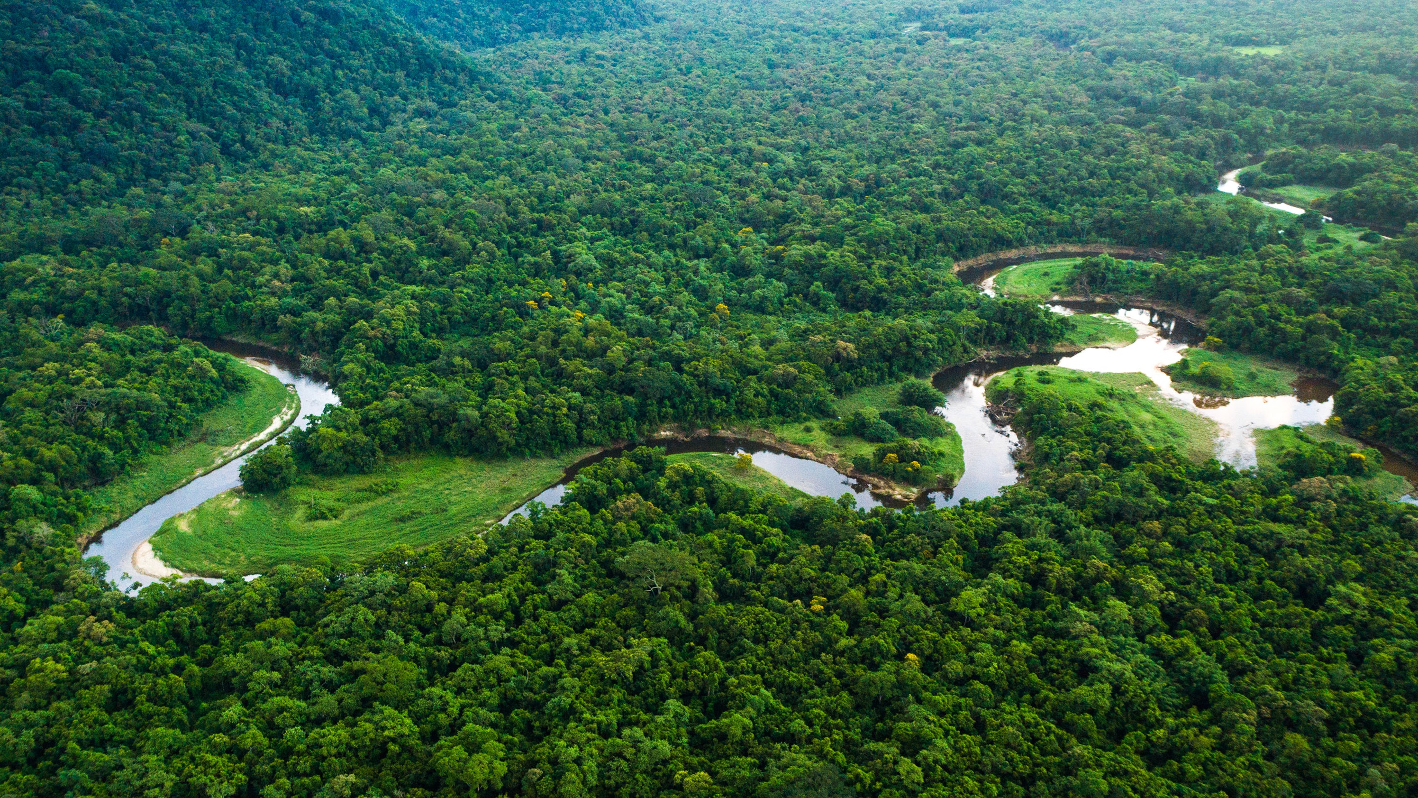

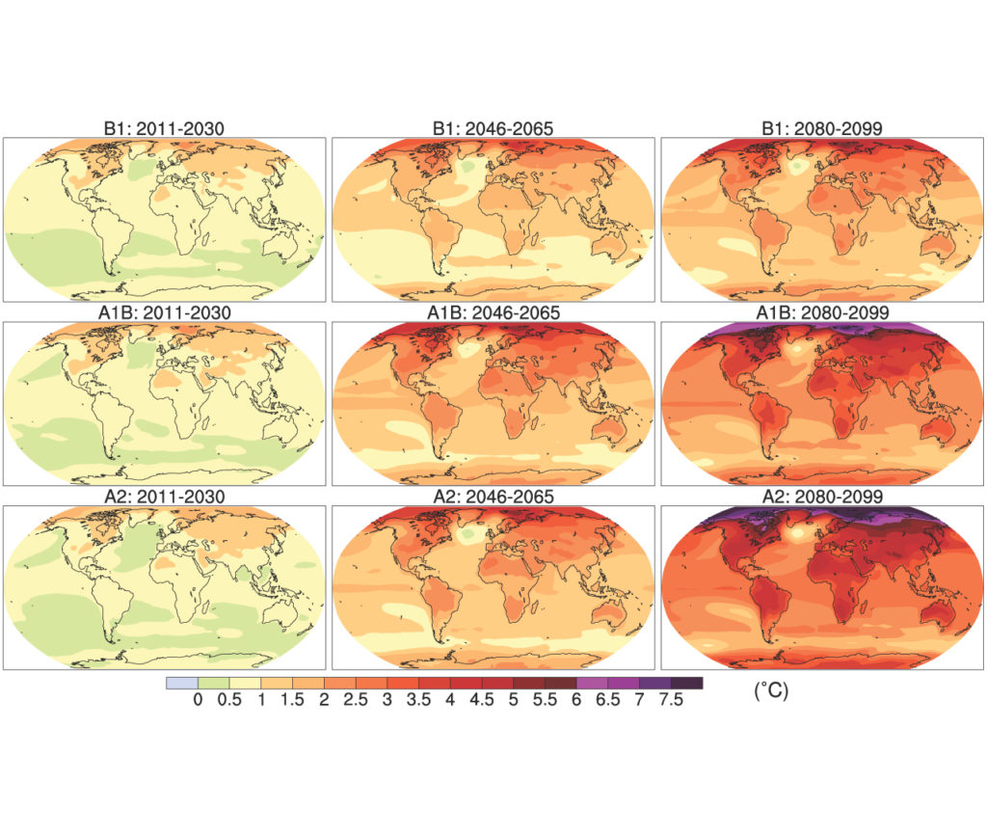
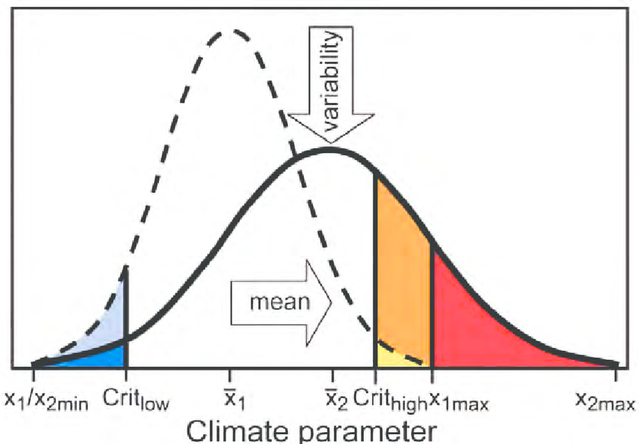
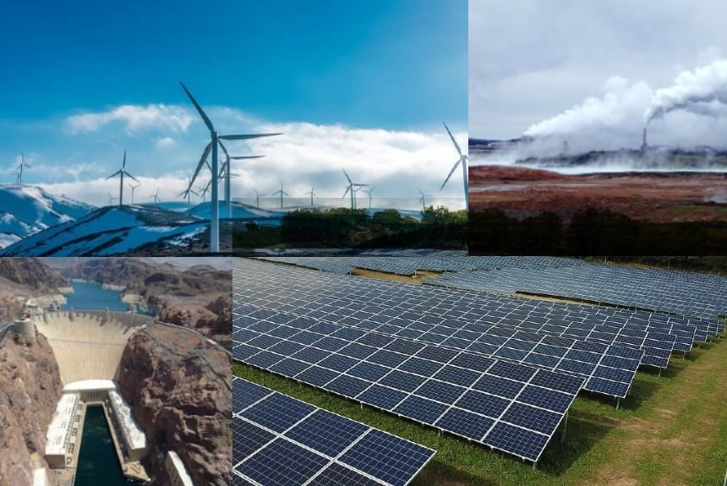
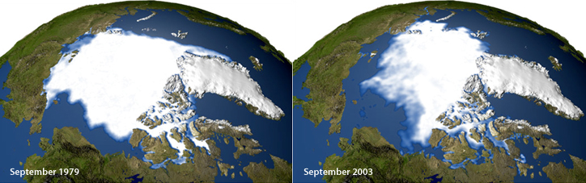
Atmosphere
Climate fundamentals
Predicting climate
Atmosphere
Global C cycle
IPCC report
Earth system models
Climate impacts
Climate solutions
Extreme events
Tipping points
Sea ice, ice caps
Energy
Mitigation
Nature-based solutions

Slide 3
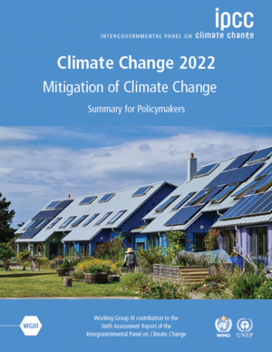
Working group 3: mitigation of climate change
Current emission reduction pledges and their effect on the climate as well as future scenarios

Slide 4
Adaptation
Redacting to the effects of climate change and reducing their effects on humans and ecosystems
Mitigation
Reducing the causes of climate change

Slide 5
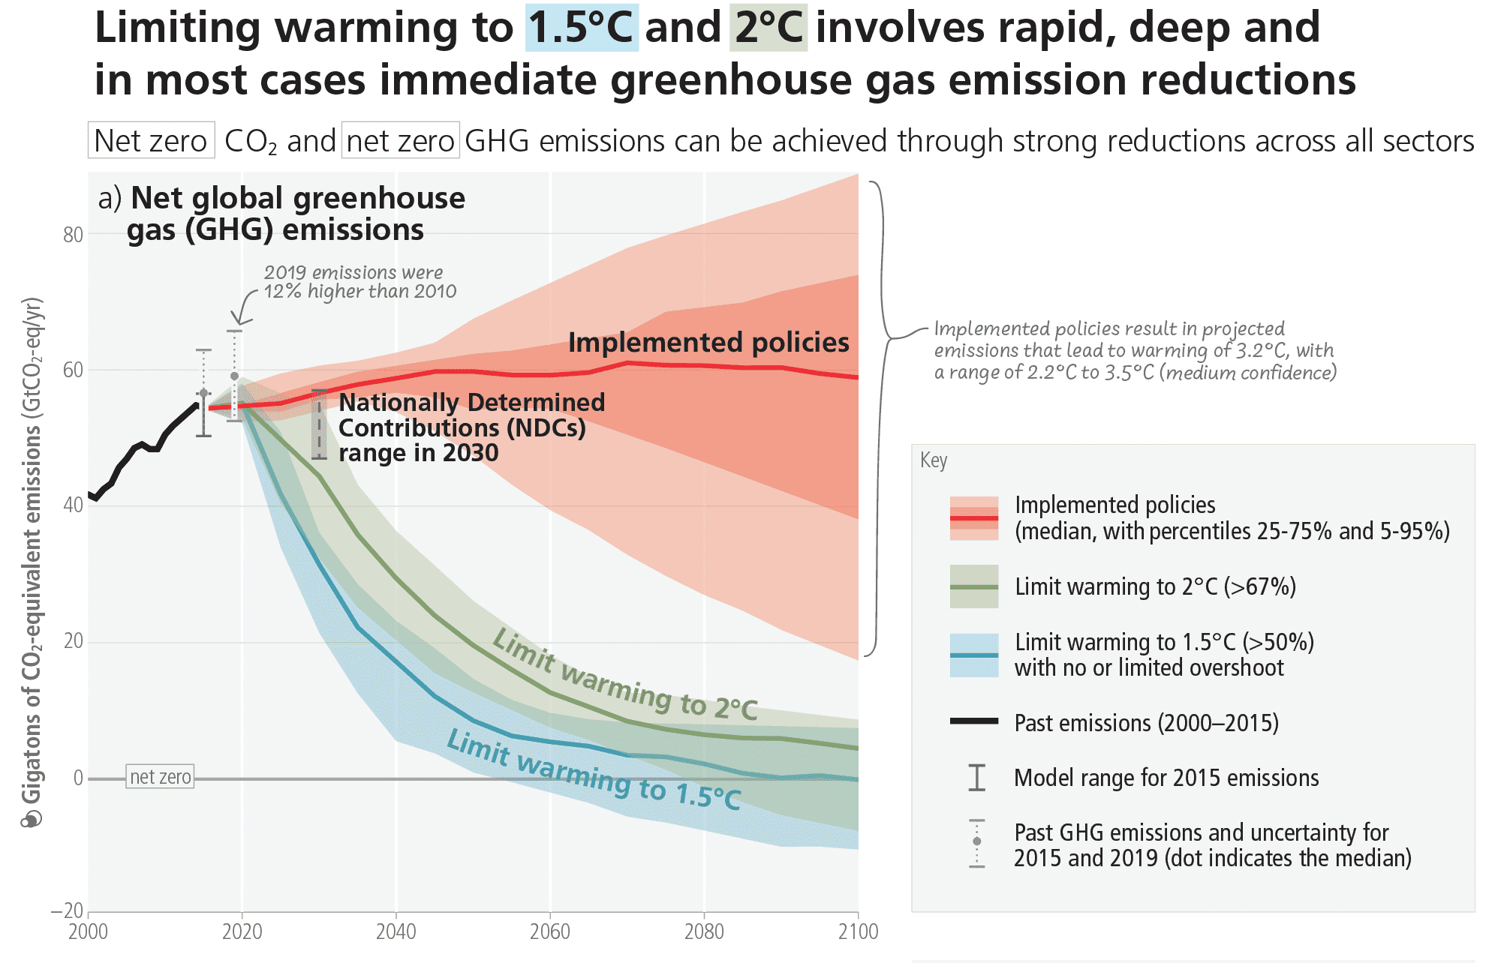
Notes:
IPCC AR6 Synthesis Report figure SPM.5

Slide 6
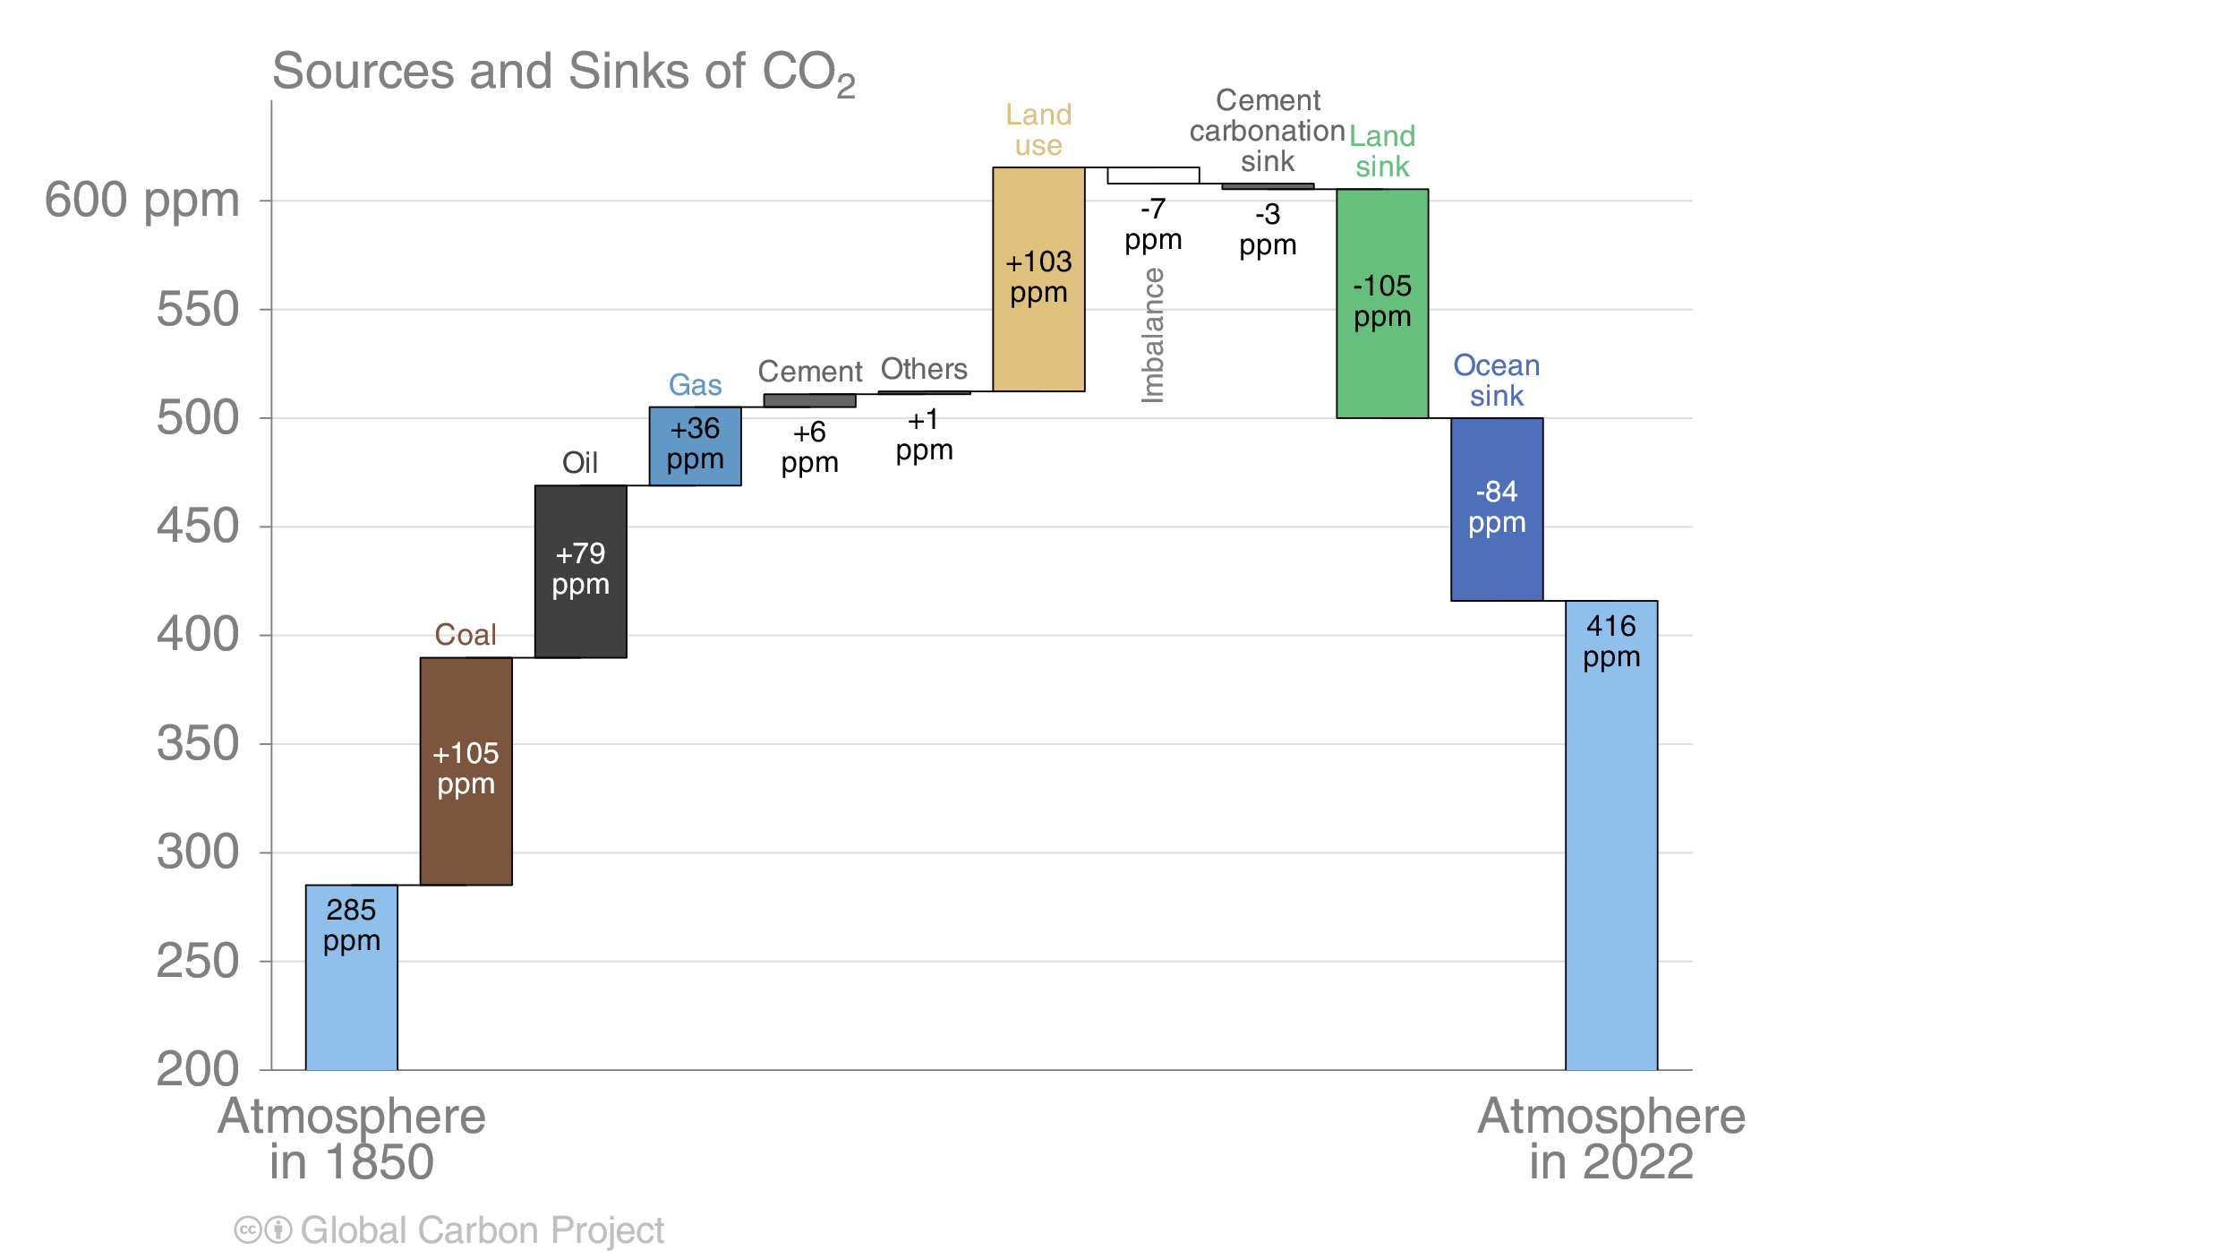

Slide 7
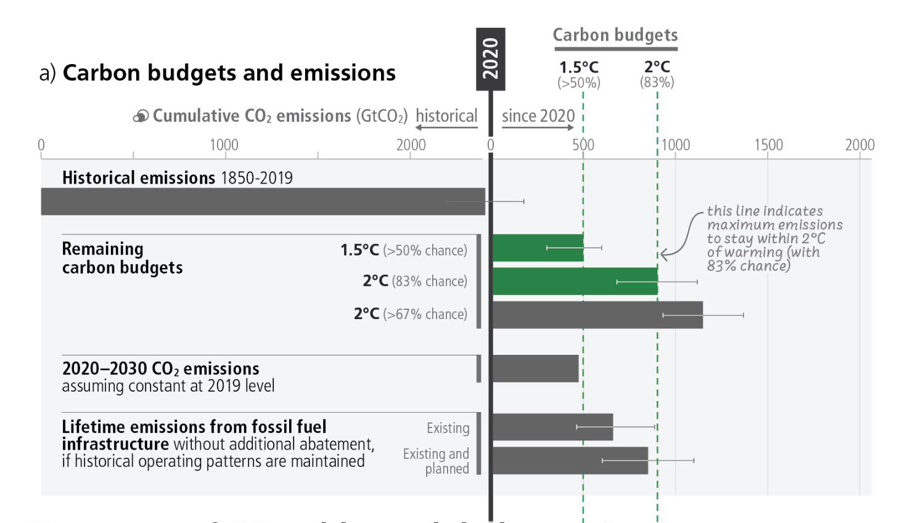
Remaining carbon budget
Notes:
IPCC AR6 Synthesis Report figure 3.5

Slide 8
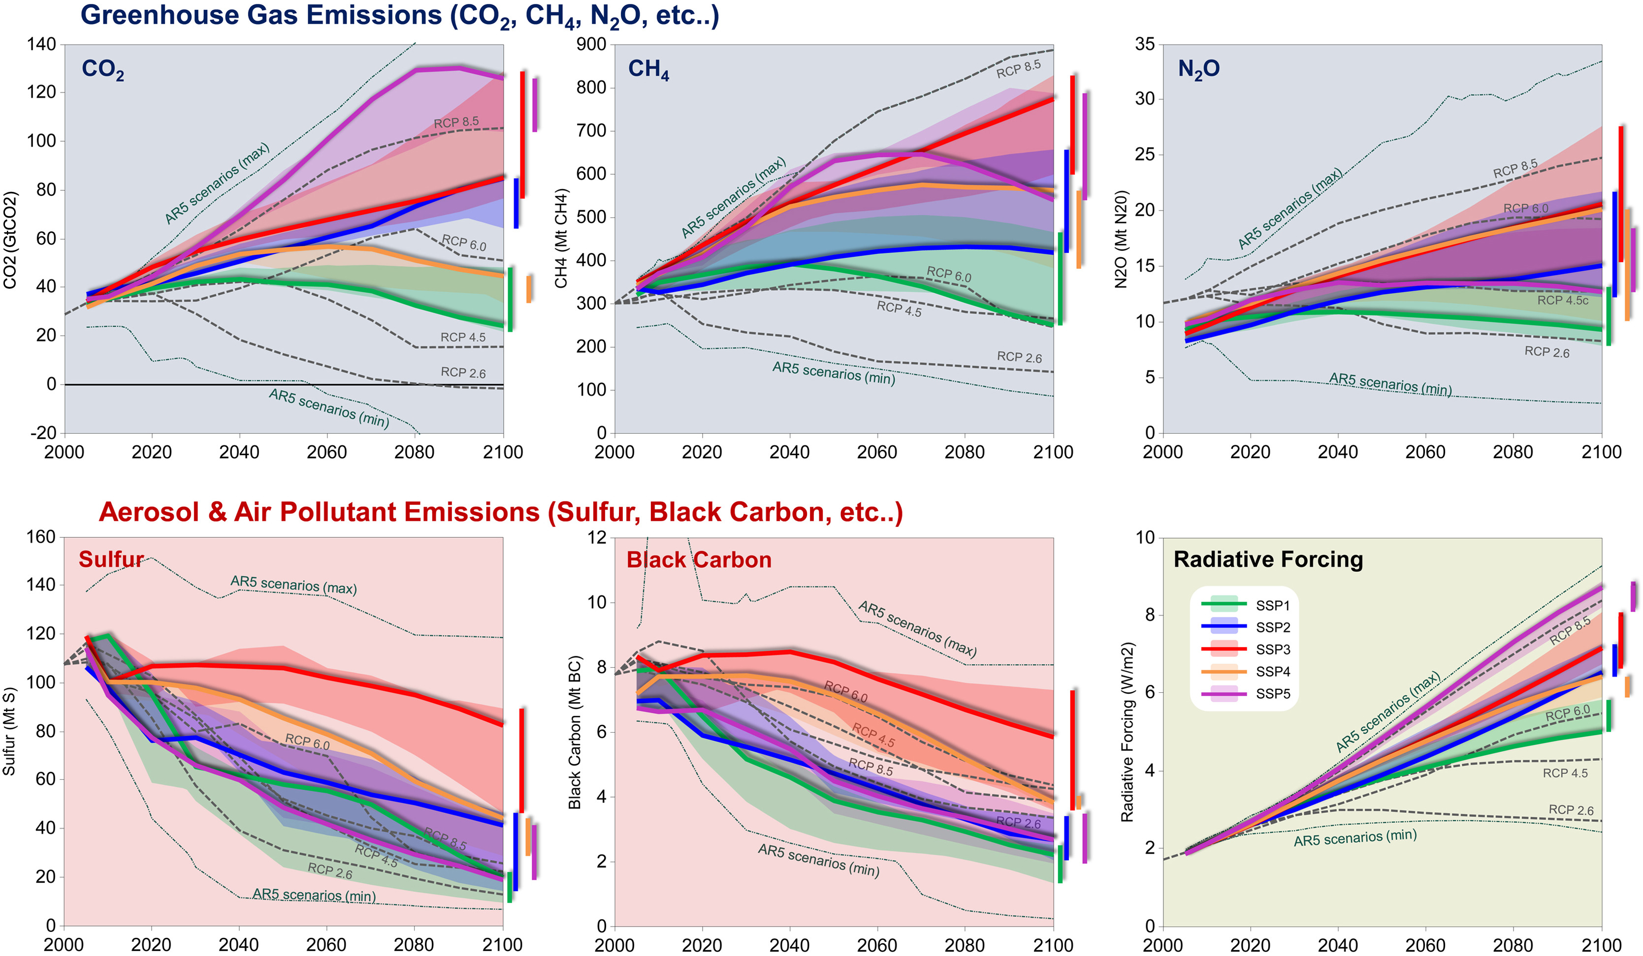
Mitigation is integral to SSP scenarios

Slide 9
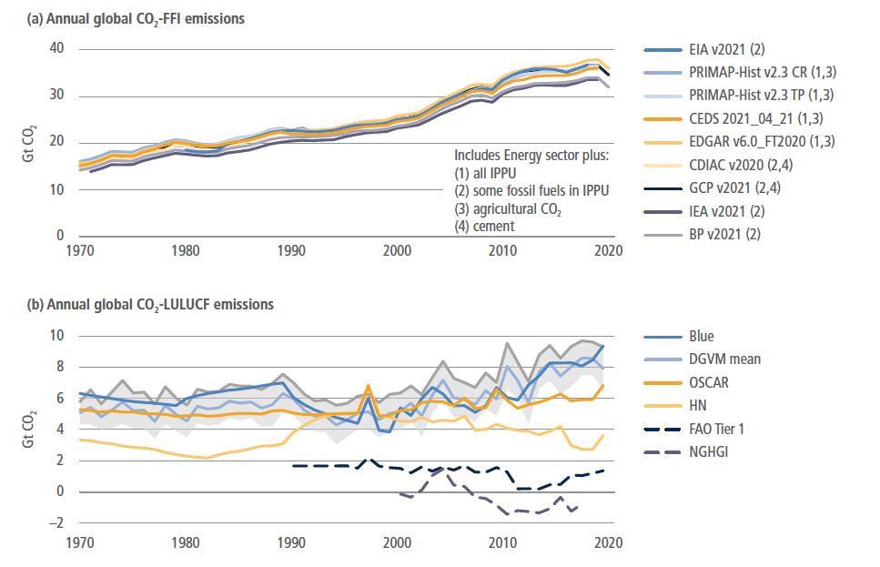
Notes:
IPCC AR6 WG III, chapter 2, figure 2.2

Slide 10
Global warming potential
Gas | Lifetime | GWP-20 | GWP-100 | GWP-500
CO₂ | Varies | 1 | 1 | 1
CH₄ | 11.8 ± 1.8 | 82.5 ± 25.8 | 29.8 ± 11 | 10.0 ± 3.8
N₂O | 109 ± 10 | 273 ± 118 | 273 ± 130 | 130 ± 64
IPCC AR6 WG1 Table 7.15

Slide 11
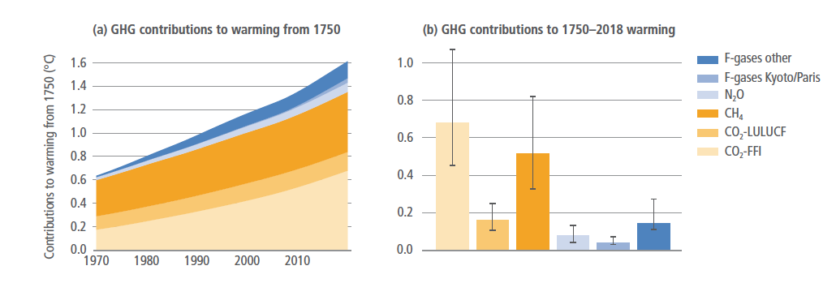
How much does each GHG matter?
Notes:
IPCC AR6 WG III, chapter 2, figure 2.4

Slide 12
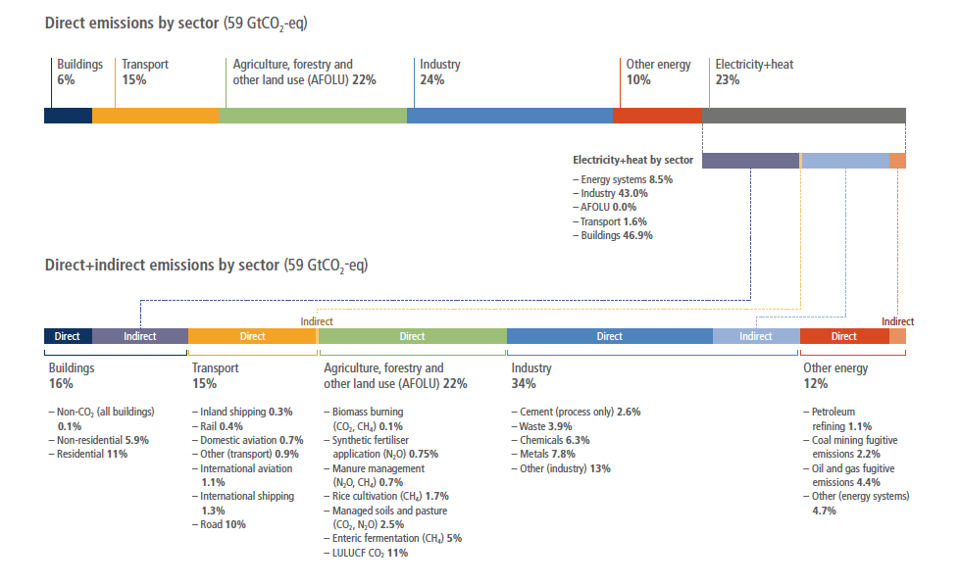
Notes:
IPCC AR6 WG III, chapter 2, figure 2.12

Slide 13
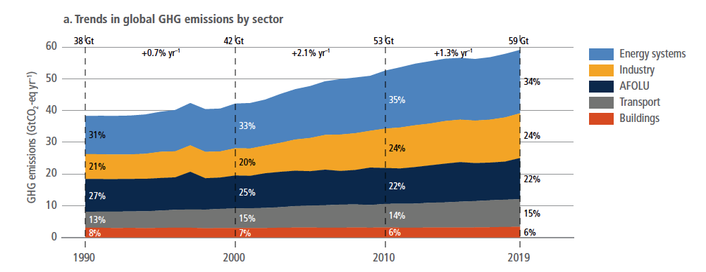
Steady increase across most sectors
Notes:
IPCC AR6 WG III, chapter 2, figure 2.13

Slide 14
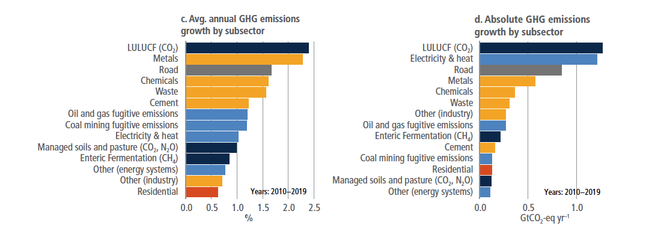
Steady increase across most sectors
Notes:
IPCC AR6 WG III, chapter 2, figure 2.13

Slide 15
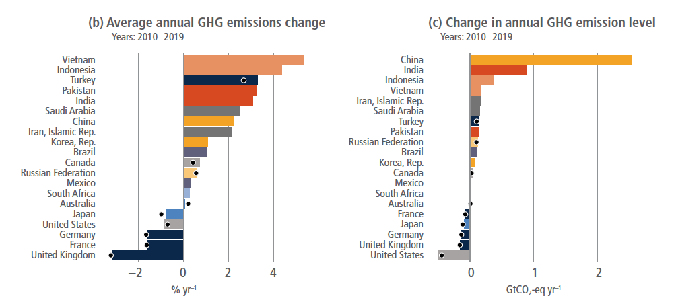
Who is changing their emissions?
Notes:
IPCC AR6 WG III, chapter 2, figure 2.9

Slide 16
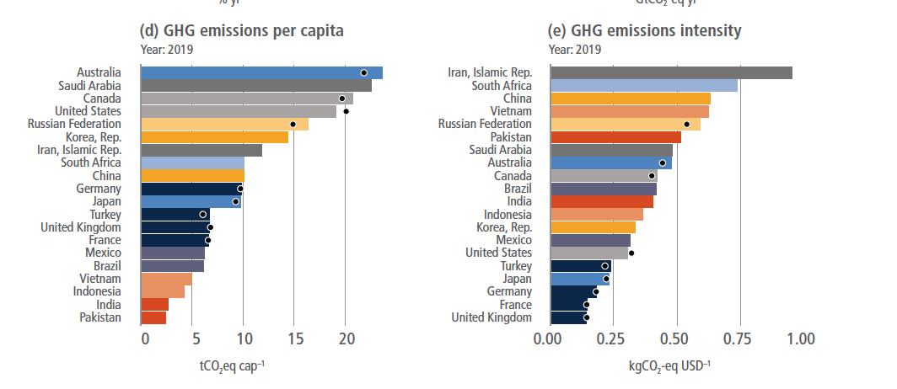
But some countries have bigger populations than others!
Notes:
IPCC AR6 WG III, chapter 2, figure 2.9

Slide 17
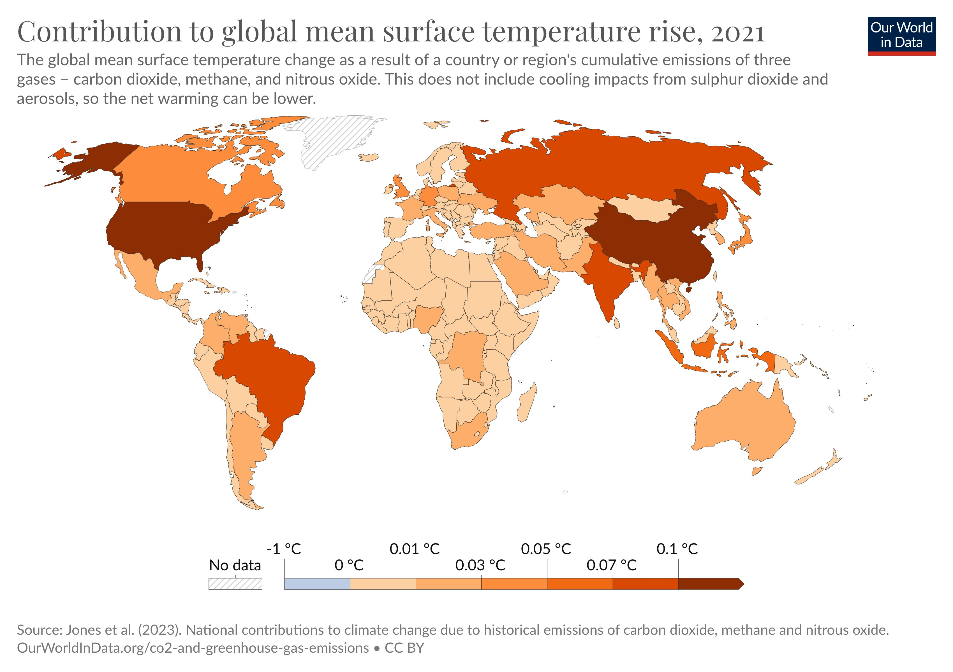
Historical blame
Notes:
https://t.co/ObRji9SXAg

Slide 18
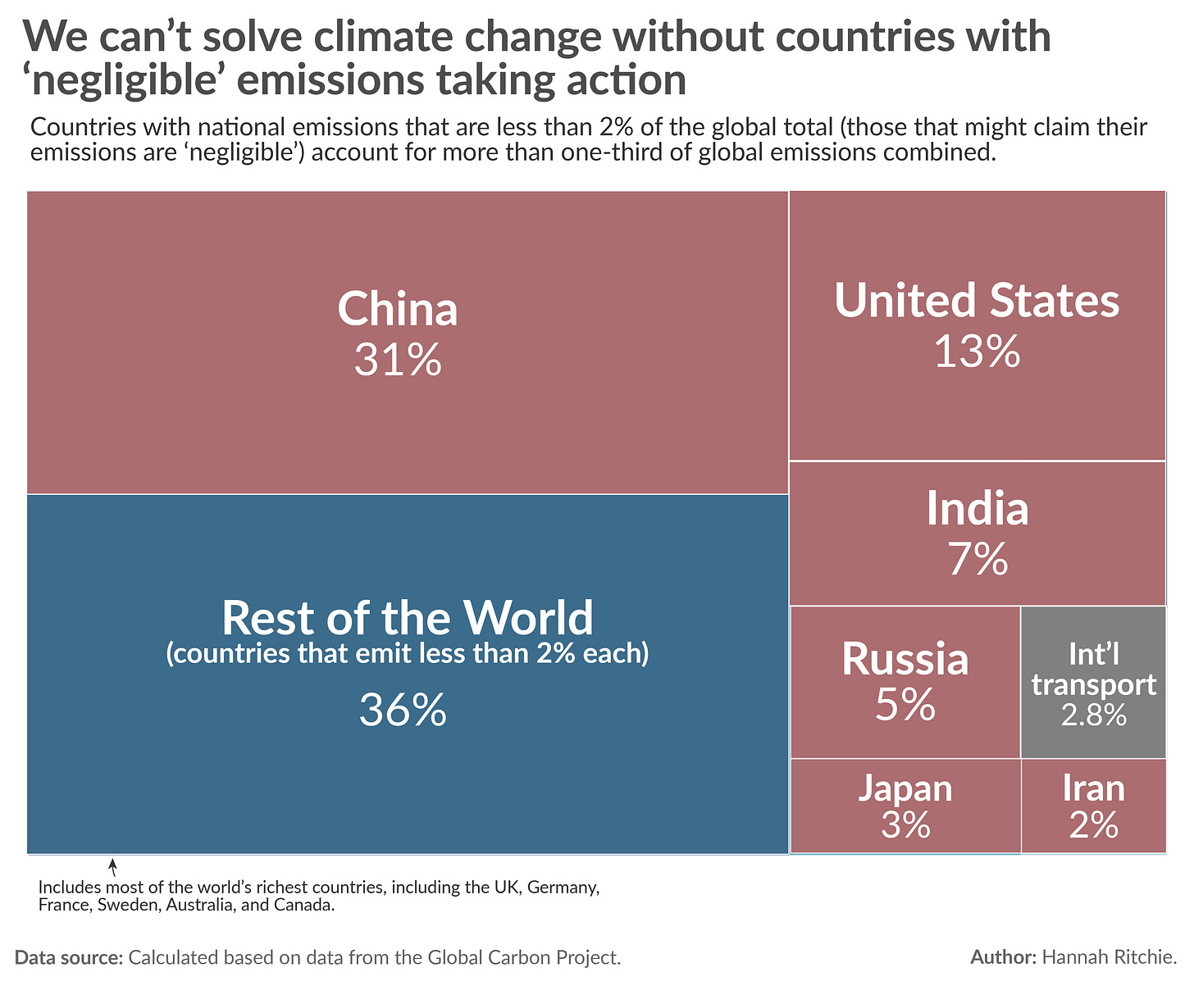

Slide 19
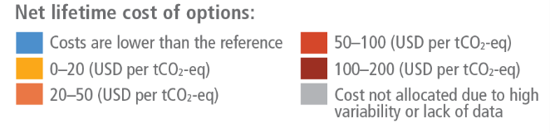
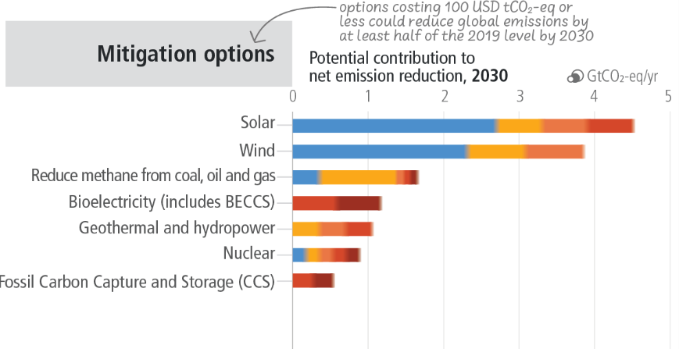
Energy mitigation
Notes:
IPCC AR6 Synthesis Report figure SPM.7

Slide 20
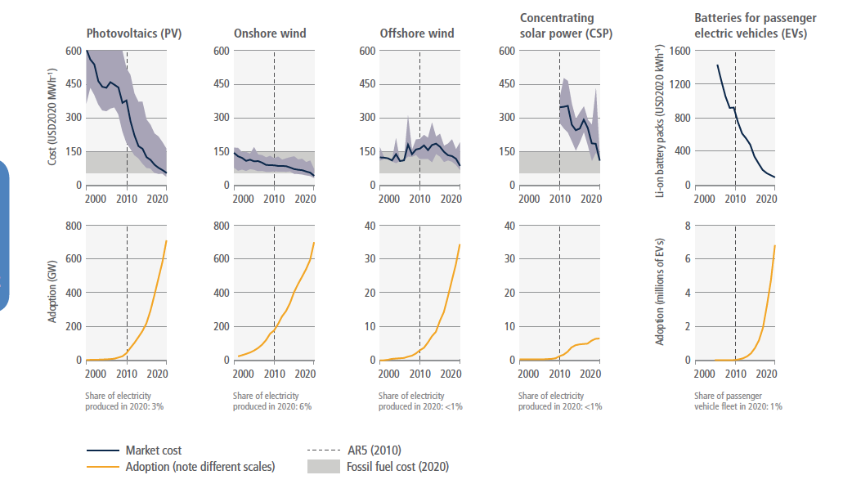
Uptake of alternative energy sources
Notes:
IPCC AR6 WG III, chapter 2, figure 2.22

Slide 21
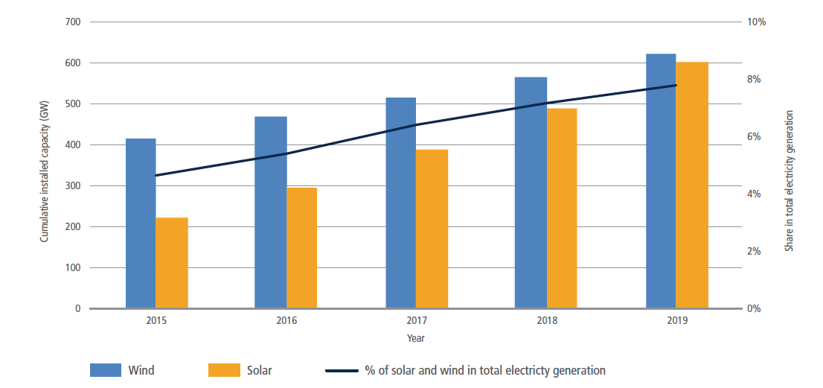
Uptake of alternative energy sources
Notes:
IPCC AR6 WG III, chapter 6, figure 6.6

Slide 22
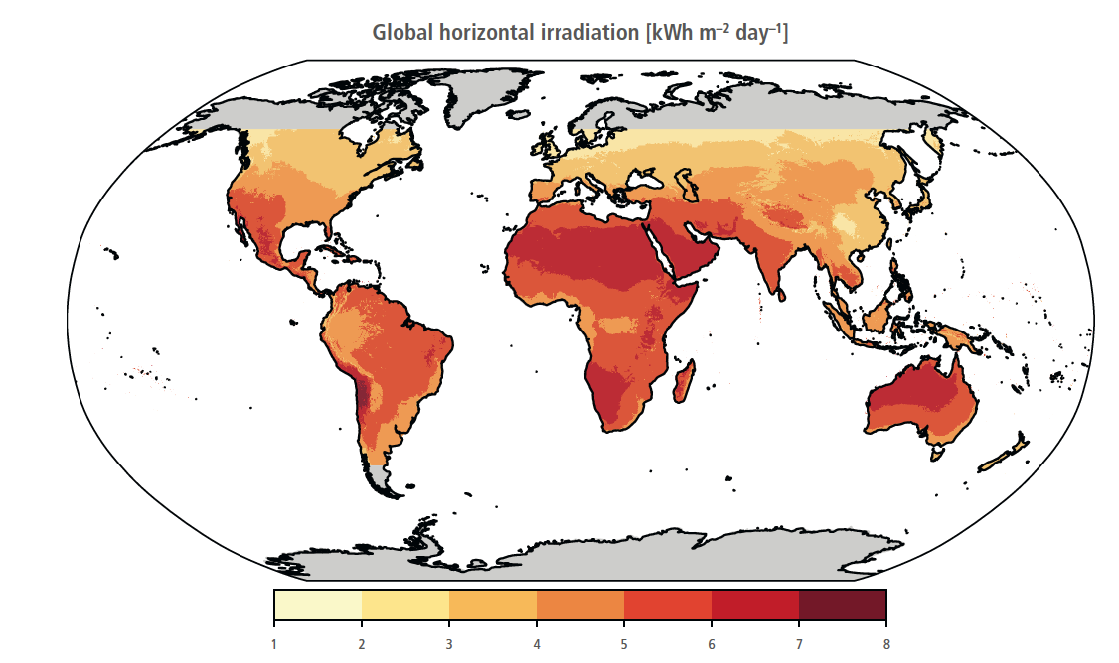
Potential for solar energy
Notes:
IPCC AR6 WG III, chapter 6, figure 6.7

Slide 23
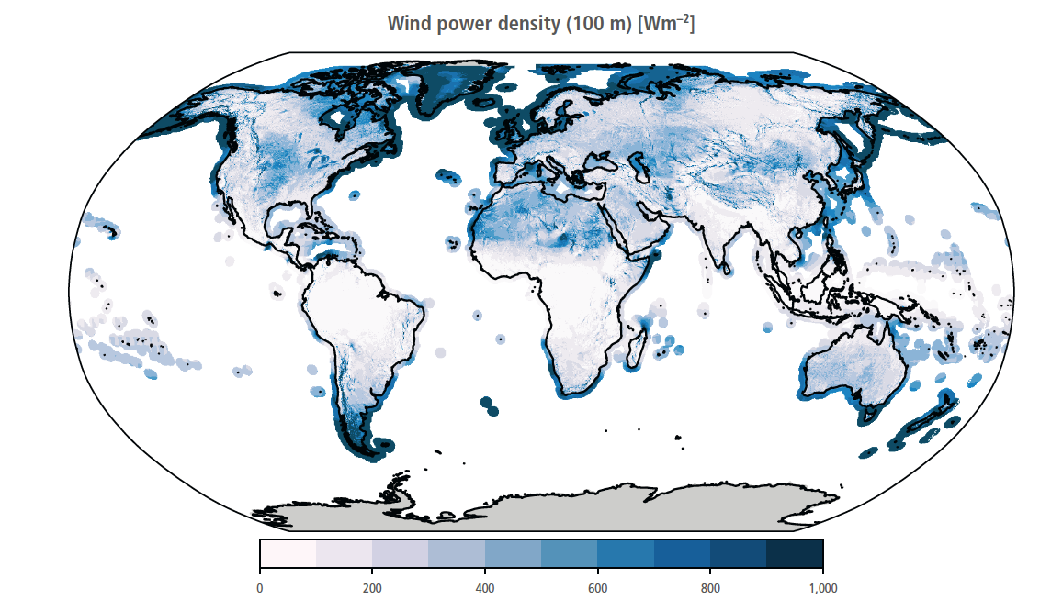
Potential for wind energy
Notes:
IPCC AR6 WG III, chapter 6, figure 6.10

Slide 24
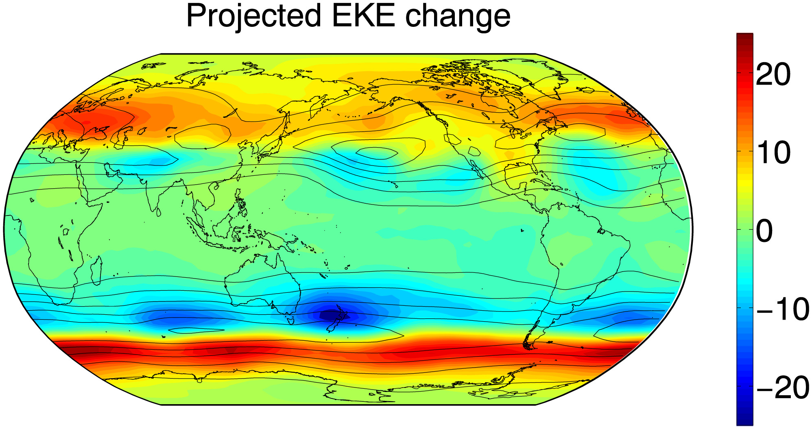
Poleward shift in extratropical storm tracks
Changes in wind intensity over the 21st century from a high end emission scenario
Higher windspeeds shifting towards higher latitudes
Caused by changes in temperature patterns
Notes:
See lecture 17 https://www.pnas.org/doi/10.1073/pnas.1812312116#:~:text=Projections%20of%2021st%20century%20climate,the%20projections%20in%20this%20season

Slide 25
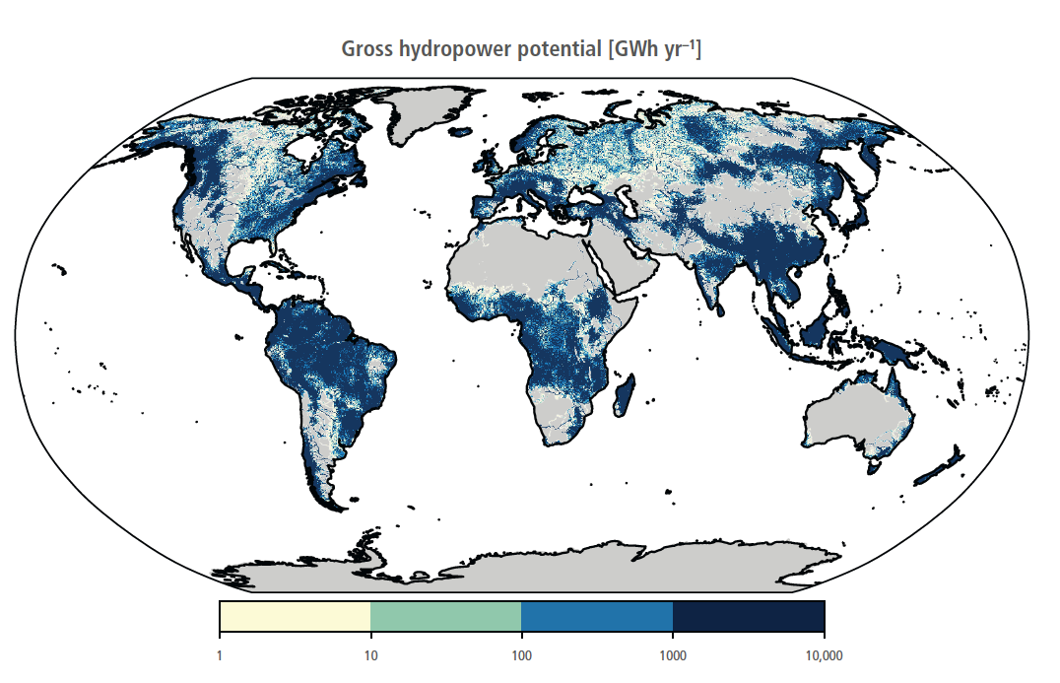
Hydropower
Notes:
IPCC AR6 WG III, chapter 6, figure 6.12

Slide 26
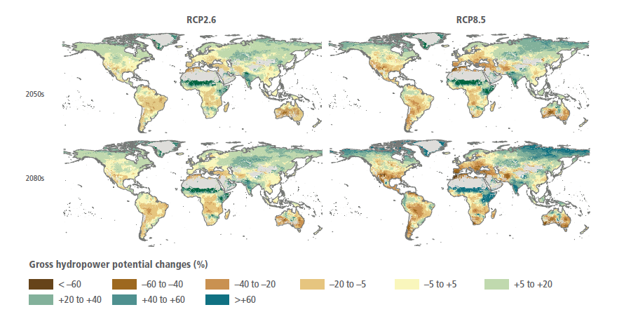
Shifts in potential hydropower
Changes in precipitation and evaporation
Droughts: short term, high impact
Notes:
IPCC AR6 WG III, chapter 6, figure 6.20

Slide 27
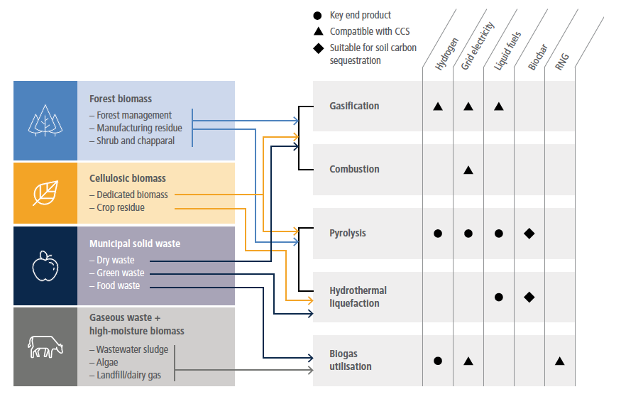
Biofuel conversion
Notes:
IPCC AR6 WG III, chapter 6, figure 6.14

Slide 28
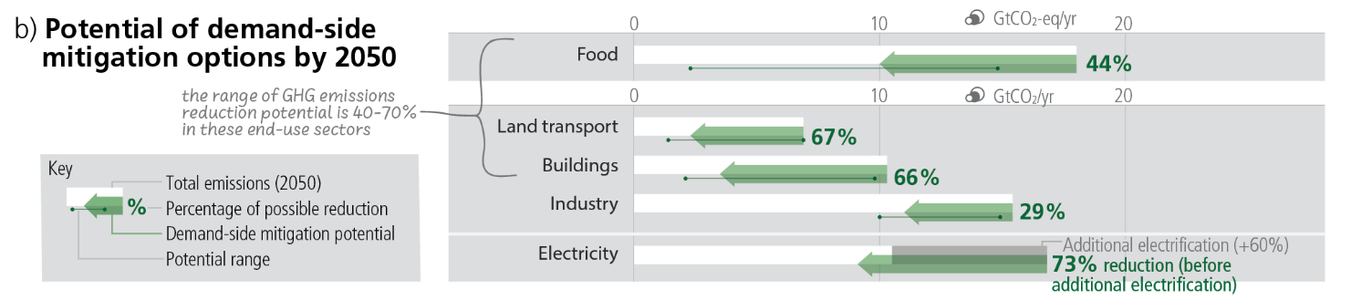
Notes:
IPCC AR6 Synthesis Report figure SPM.7

Slide 29
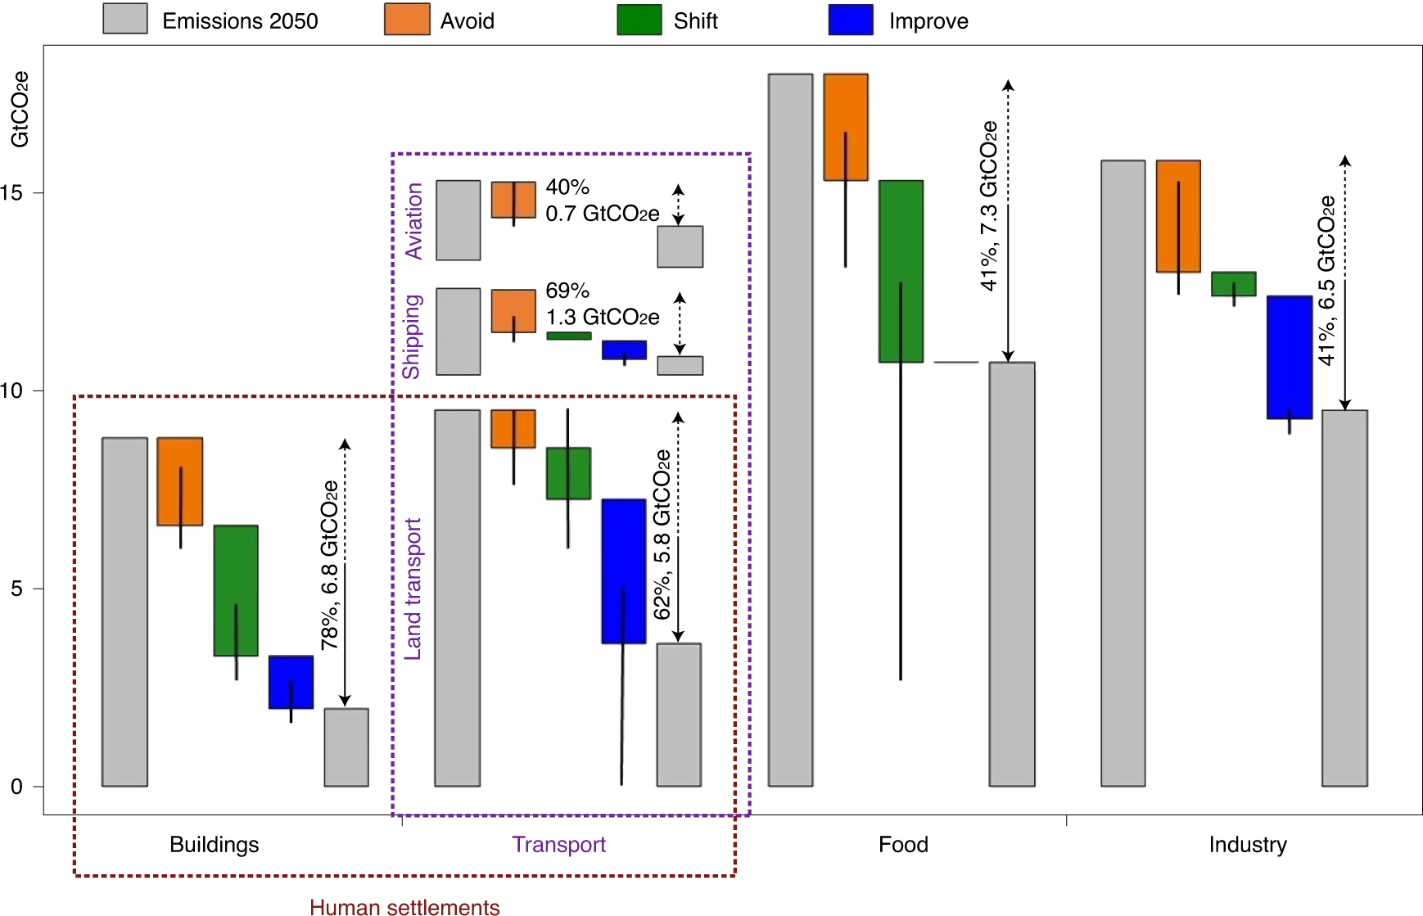
Reducing demand
Notes:
https://www.nature.com/articles/s41558-021-01219-y

Slide 30
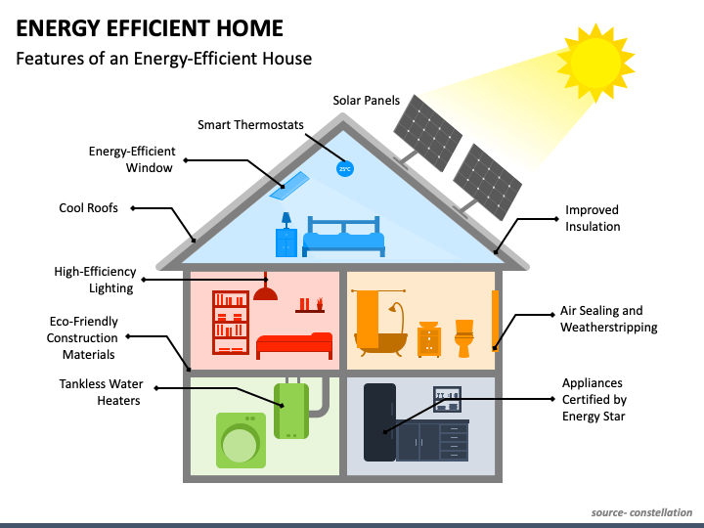
Energy efficiency

Slide 31
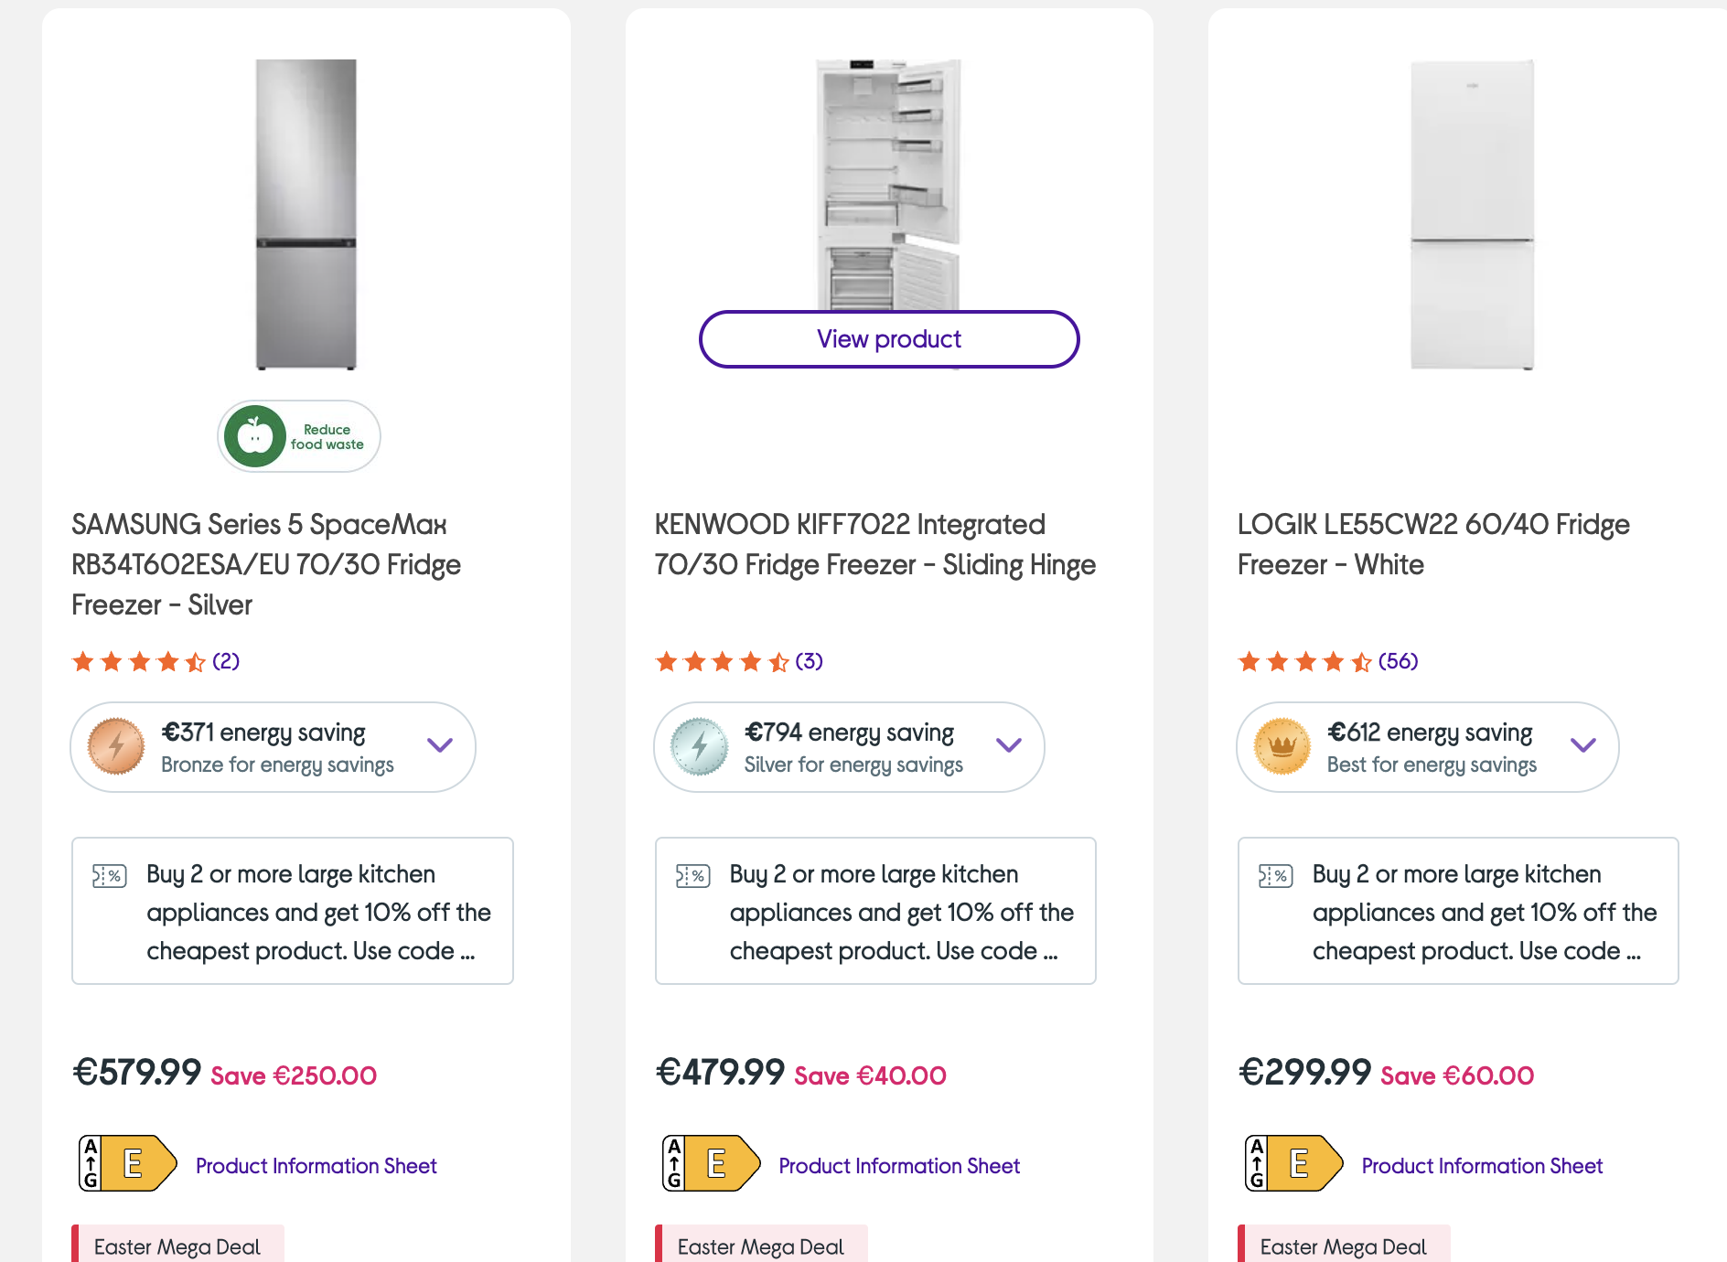
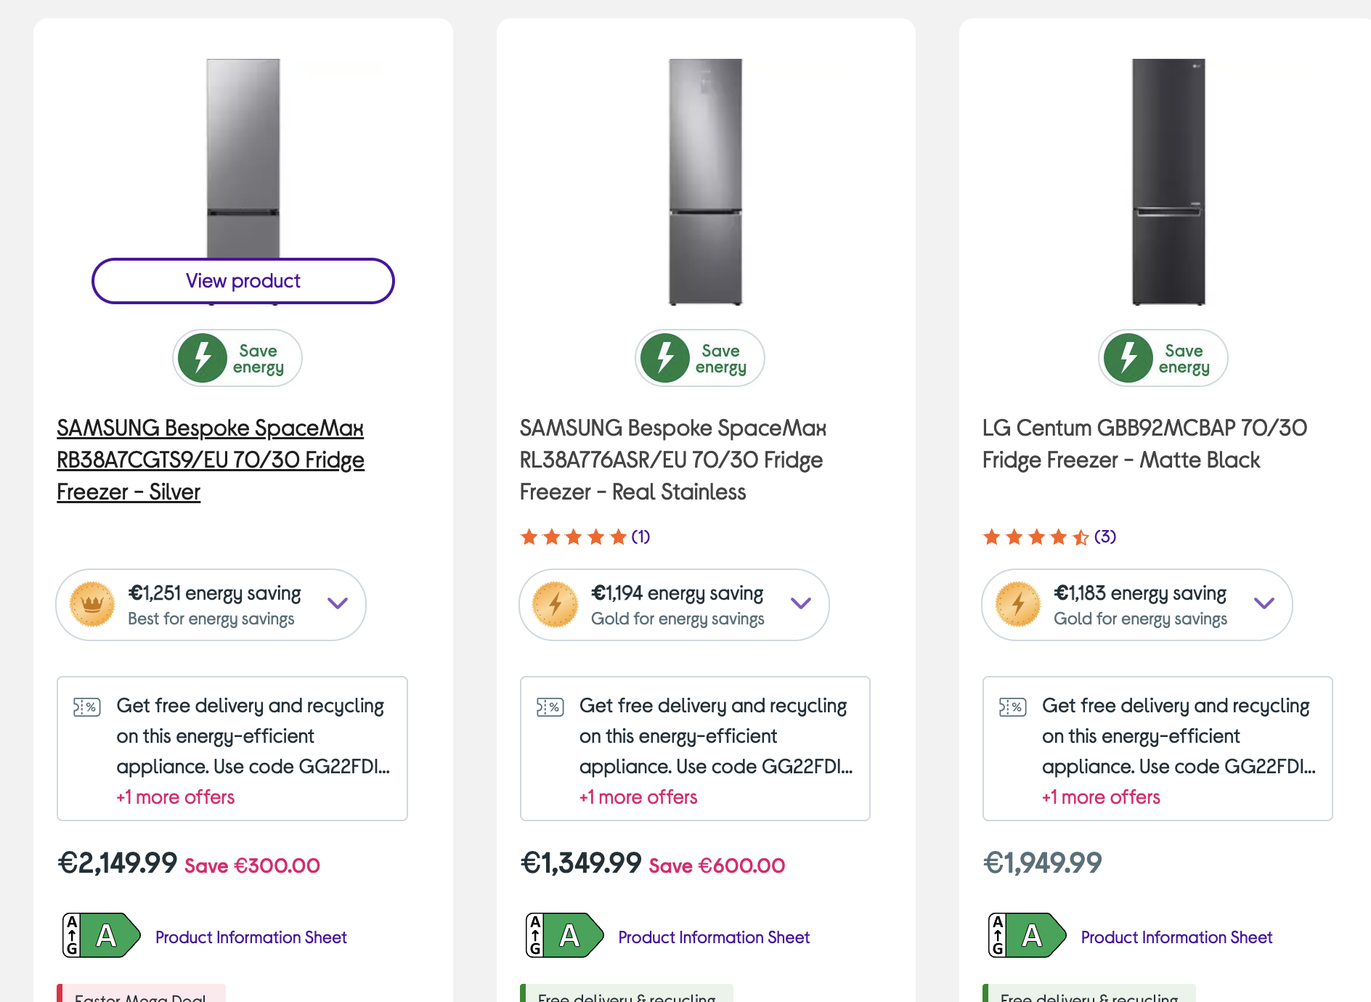
Social inequality

Slide 32
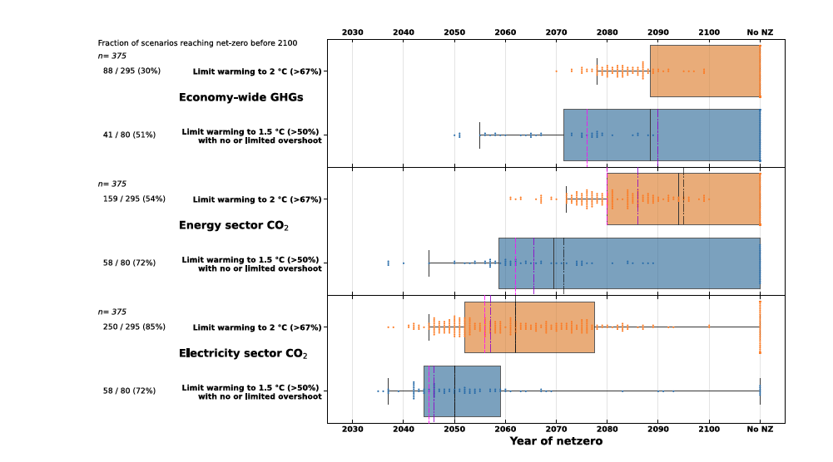
How much time do we have?
Notes:
IPCC AR6 WG III, chapter 6, figure 6.28

Slide 33
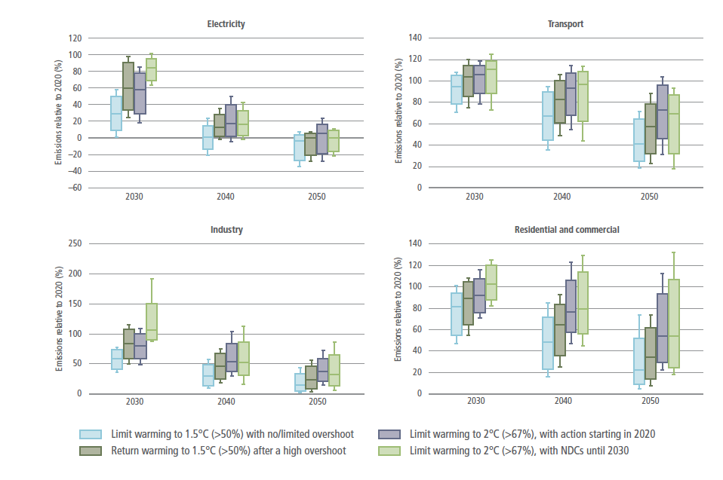
Potential for overshoot or delayed action
Notes:
IPCC AR6 WG III, chapter 6, figure 6.29

Slide 34
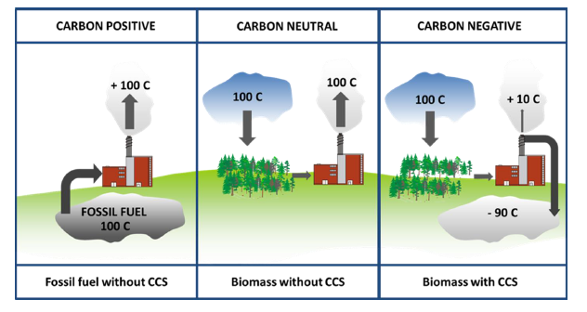
Carbon capture and storage
Technologies for removing and storing CO2 from the atmosphere
Uncertain and expensive

Slide 35
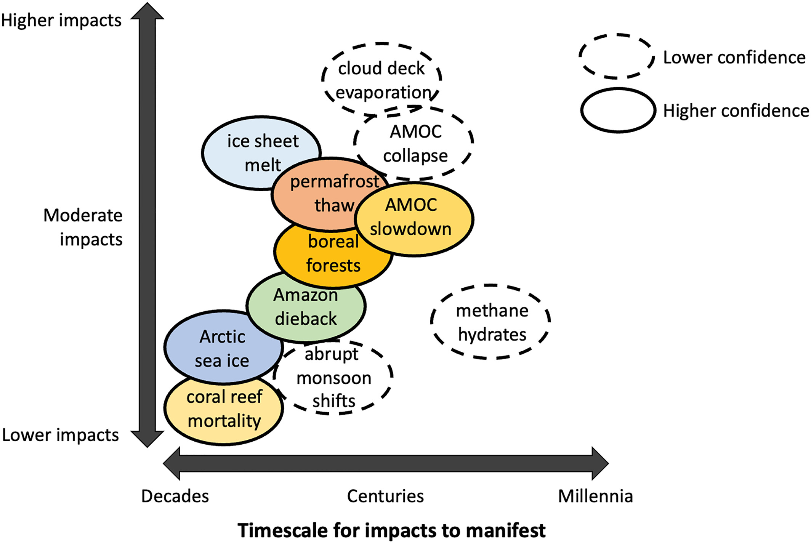

Slide 36
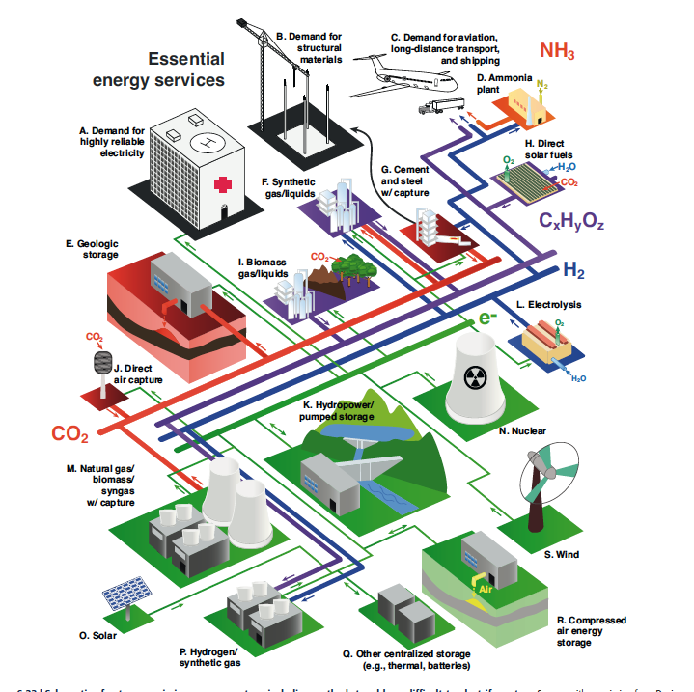
A multi source energy system

Slide 37

Climate and other things

Slide 38
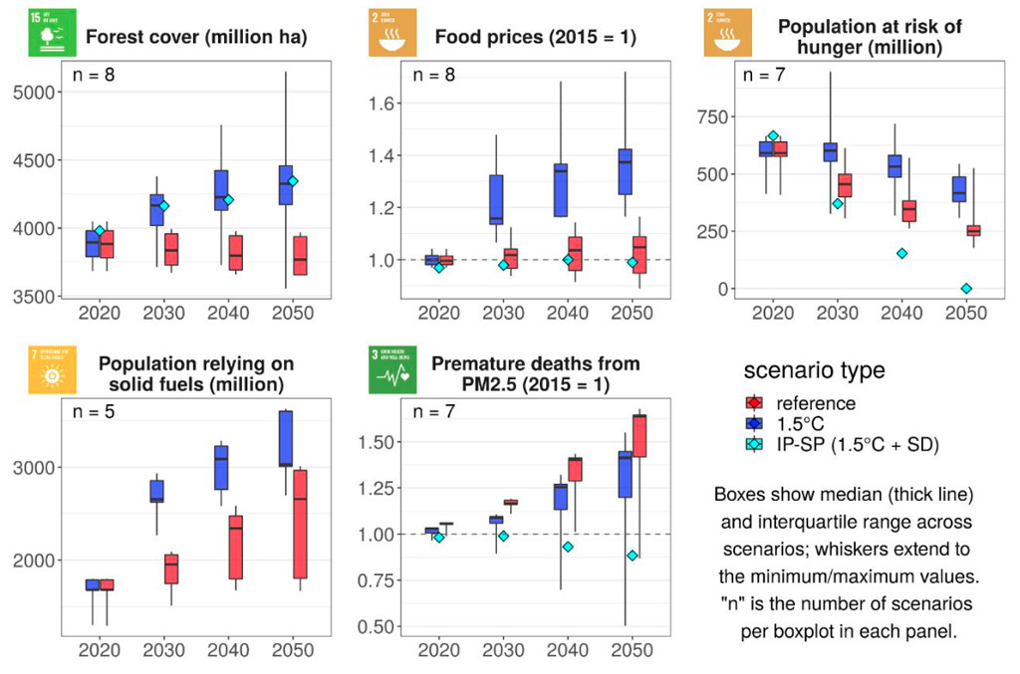
Climate and other things
Notes:
IPCC AR6, WG III, chapter 3, figure 3.38

